Slide 1
Midas Funding
Team 3
Anazsa Blanding
Kevin Barone
Ryan Emenheiser
Seth Kerr

Slide 2
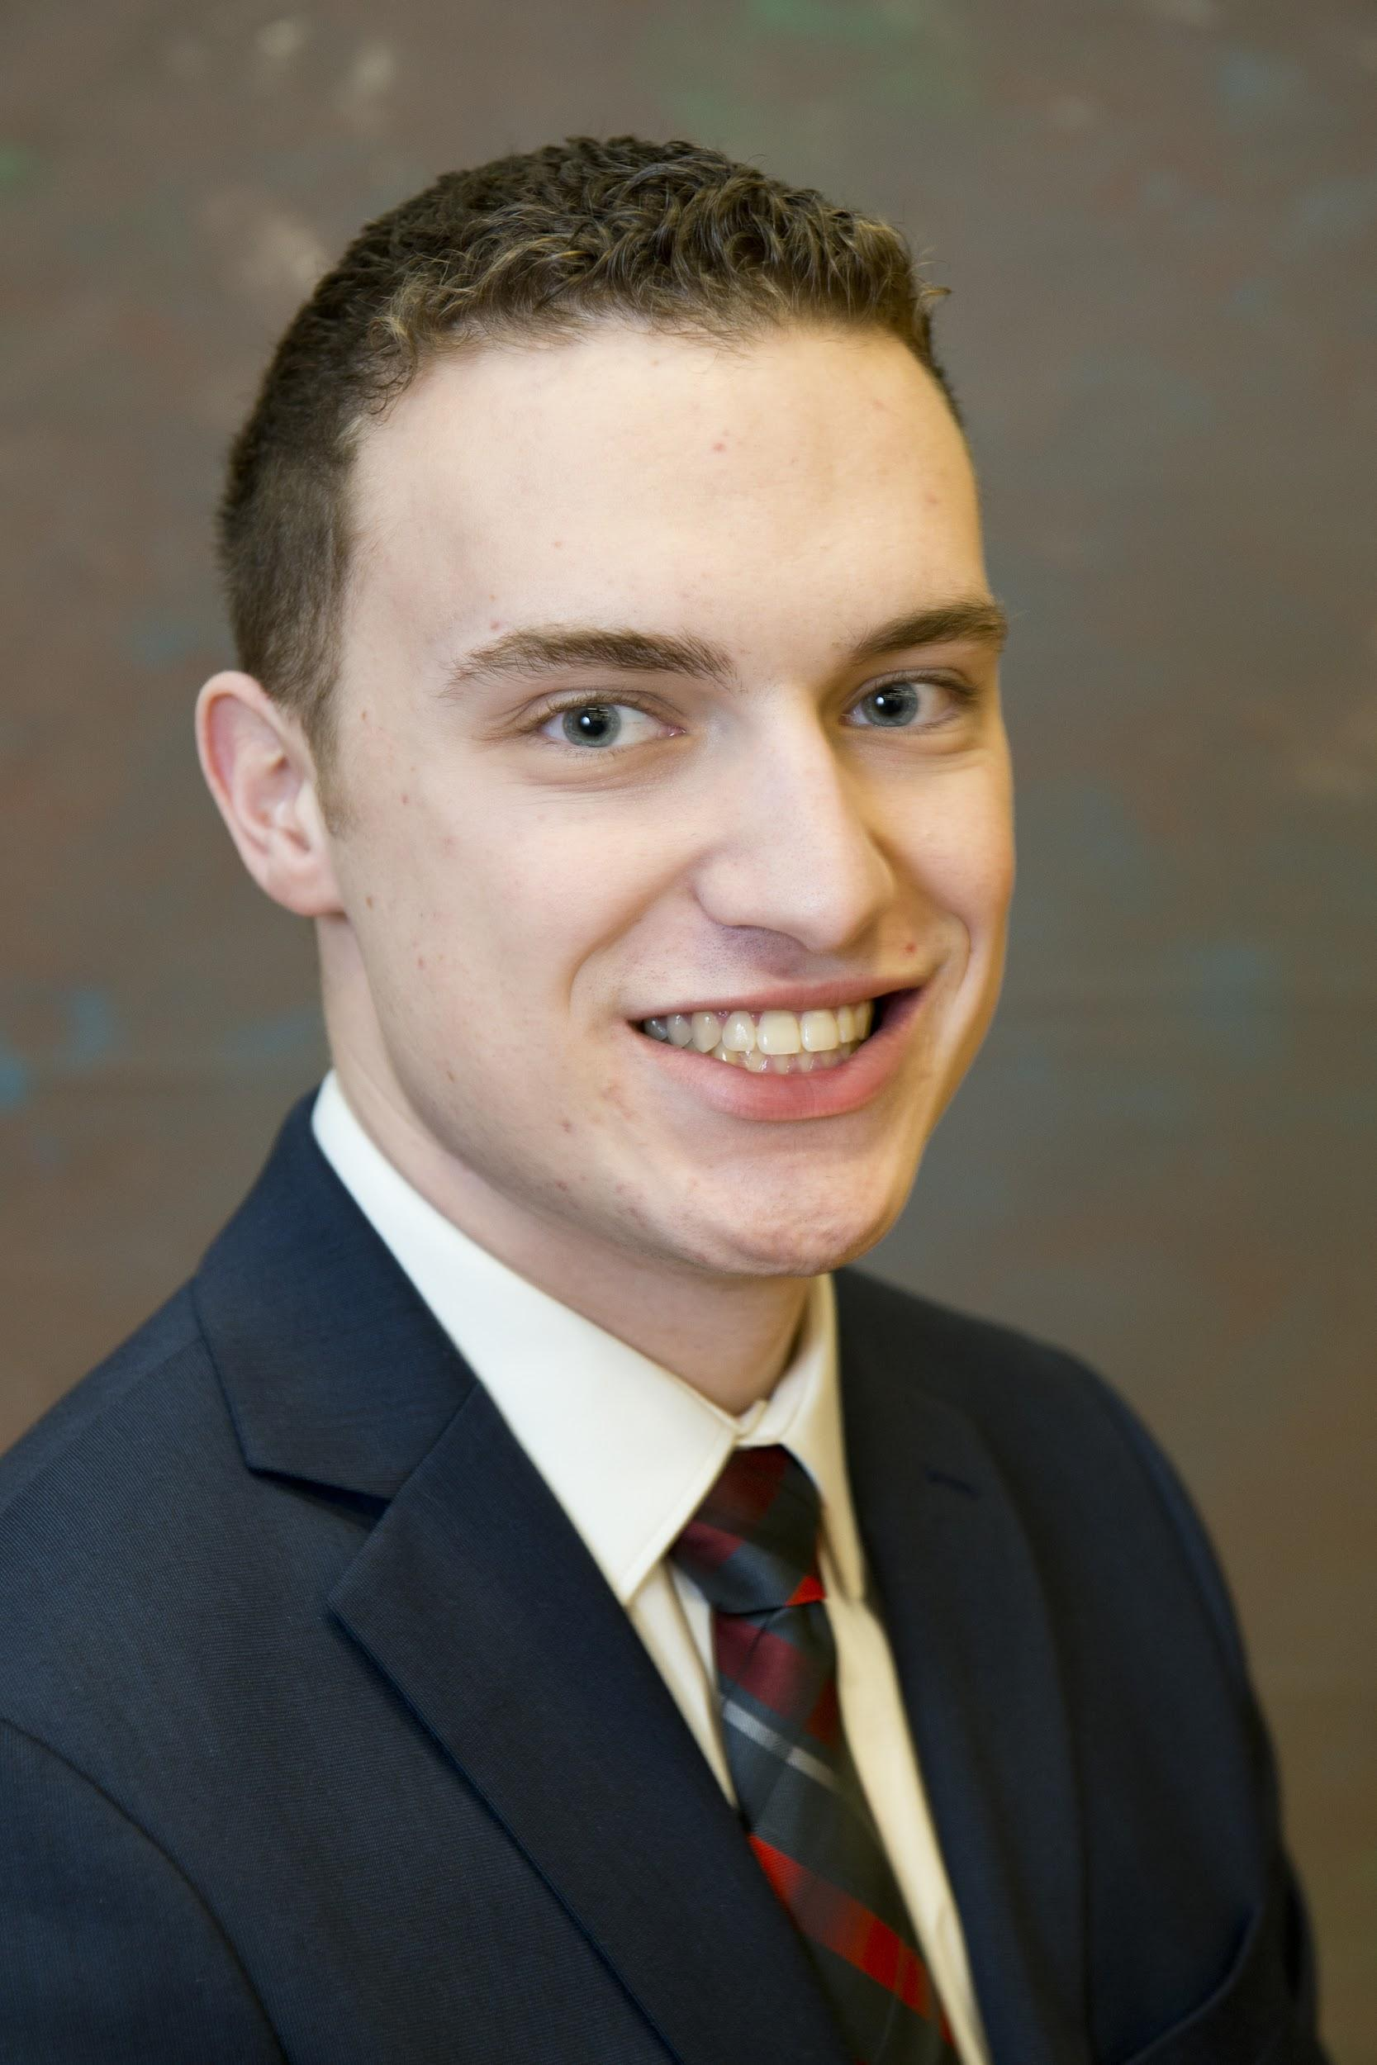
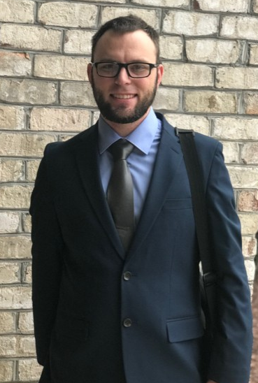
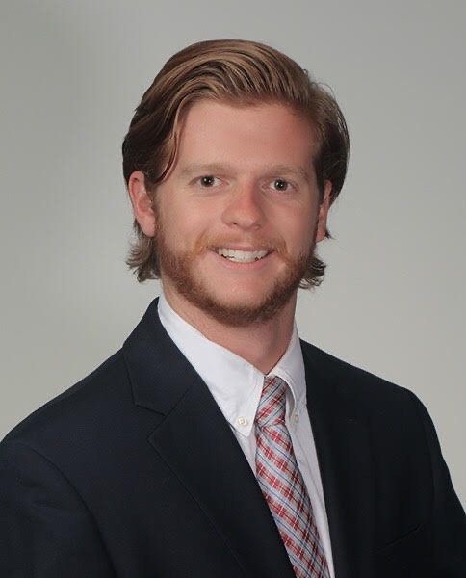
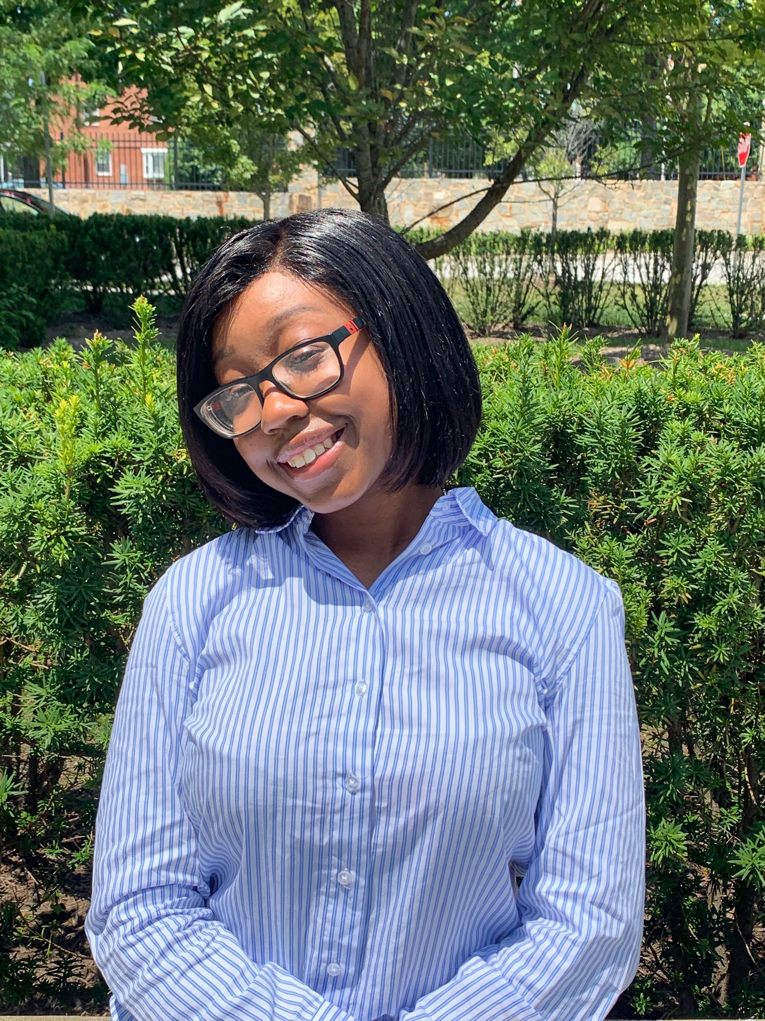
Meet the Team (Midas Touch)
Ryan Emenheiser
University of Delaware
B.S. Computer Science
I have a 279 high game in bowling
Seth Kerr
North Carolina A&T
B.S. Computer Engineering
Kevin Barone
Georgia Institute of Technology
B.S. Computer Science
I am currently developing a video game with my friends.
Anazsa Blanding
Morgan State University
B.S Computer Science
I trade in the foreign exchange market.
I develop open source hardware projects

Slide 3

The Problem
Midas needs a technological solution in order to:
Increase community engagement
Gamify donor activity
Notes:
Ryan
How to leverage technology in order to: Engage institutions and individuals Incentivise donations Share organizational progress and updates

Slide 4
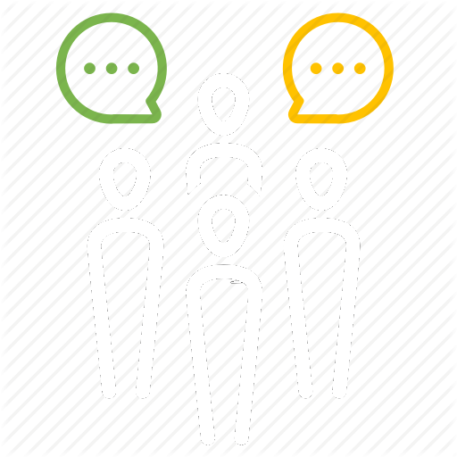


The Approach
Consider Best Potential Solutions
User Stories
Feature Breakdown
Prioritize
Open ended project
Dashboard solution reached
Schedule Stand Ups
Determine what a user wants
Create scenarios
Make wireframes
Seth: User Registration
Kevin: Donor Dashboard
Anazsa: Financial Literacy Dashboard
Ryan: Financial Advisor Dashboard
Essential Features
Stretch goals
Future implementations
Notes:
Seth
Mention scrum and daily standup meetings

Slide 5
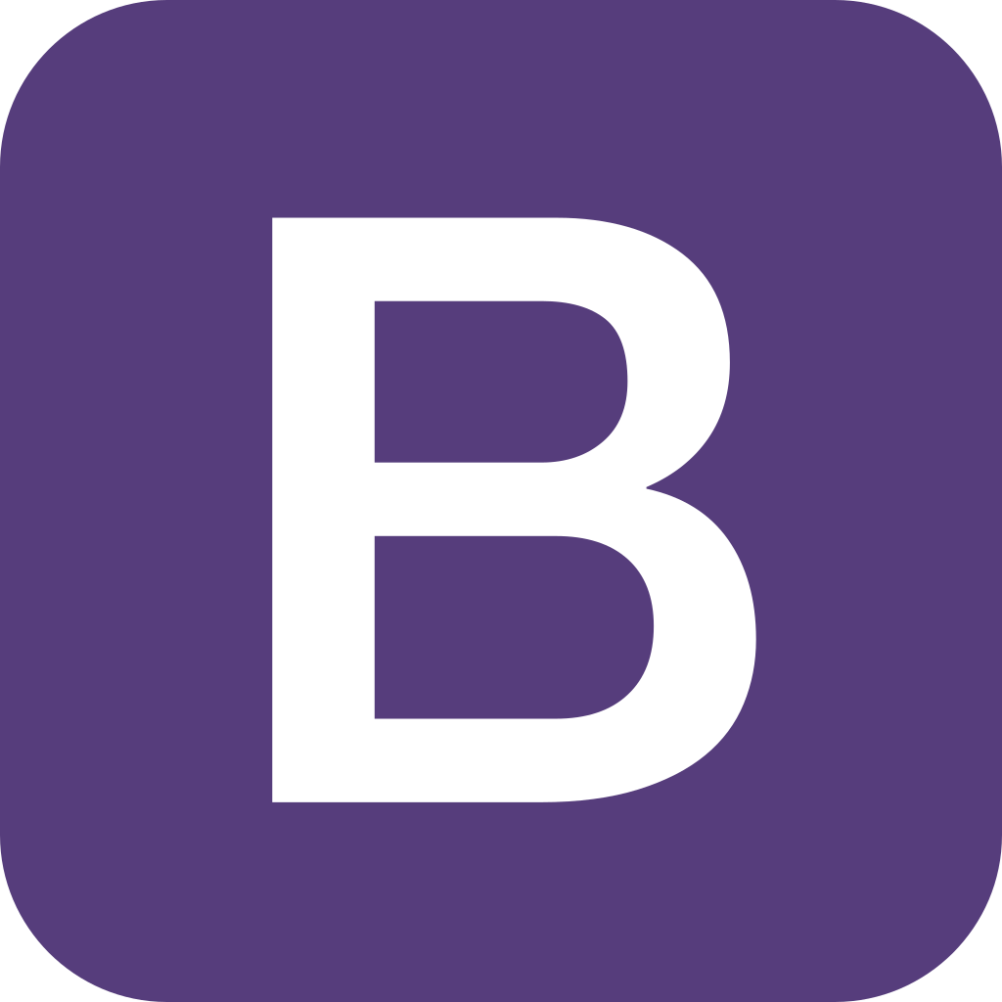

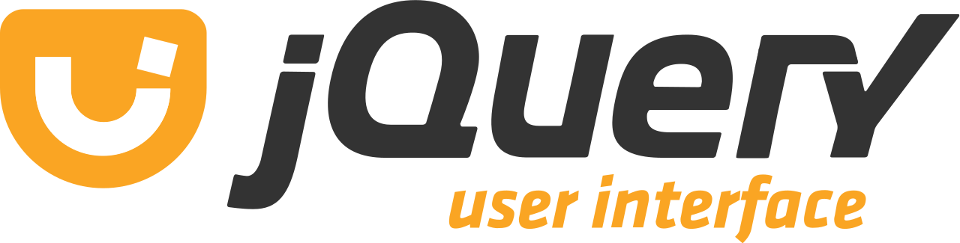

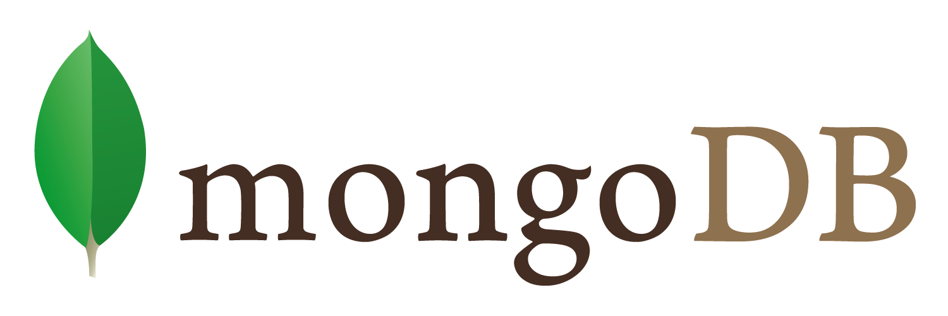

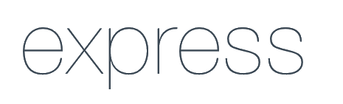
The Solution
A dashboard that allows for a multitude of users to stay engaged with The Midas Collaborative using gamification and financial resources.
Frontend
Utilize Bootstrap 5 and Vanilla JavaScript to visualize frontend
1
Middleware
Use jQuery and Socket.io to provide data asynchronous data pipeline
2
Backend
Utilize NodeJS, ExpressJS, and Mongoose to provide an API endpoint and backbone for website.
3
Database
Utilize MongoDB to provide flexible database for user data
4
Notes:
Seth Talks about this one
Talk about solution verbally

Slide 6
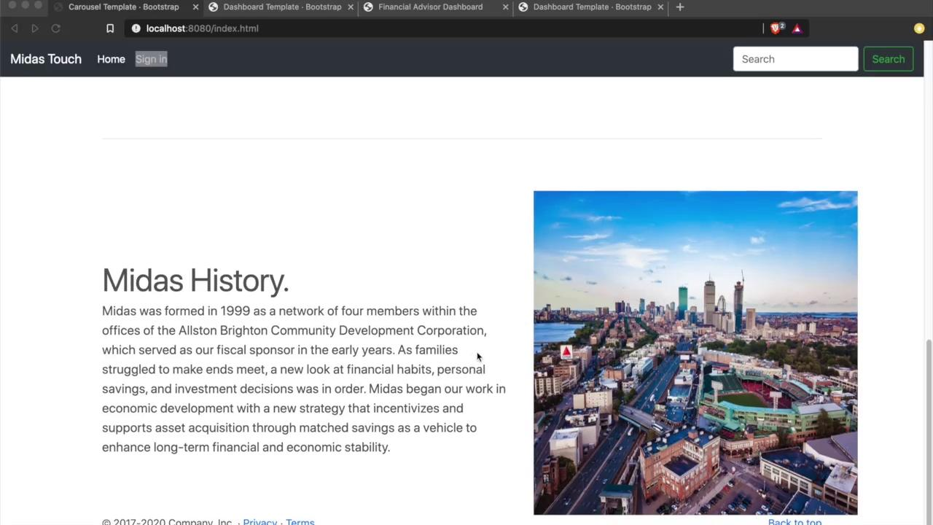
Demo
Notes:
Ryan

Slide 7
Potential Impacts on Midas Collaborative
Individual and
Corporate Donors
Financial
Advisors
Financial Literacy Clients
Incentivized donations with leaderboard system
Directly reach out to Financial Literacy Clients
Fast access to Midas Tools and Advisors
Increase in donor interactions
Encourages participation in Midas
Tailored programs for lower income individuals
Exposure to Midas’ financial literacy network
Increase in financial confidence
More productive interactions between advisors and advisees
Notes:
Kevin
Increase donations via gamification and rewards program
Increase midas impact on financial literacy
Financial advisors involved
Financial literacy members track their spending and communicate with fin advisors
ing and communicate with fin advisors

Slide 8









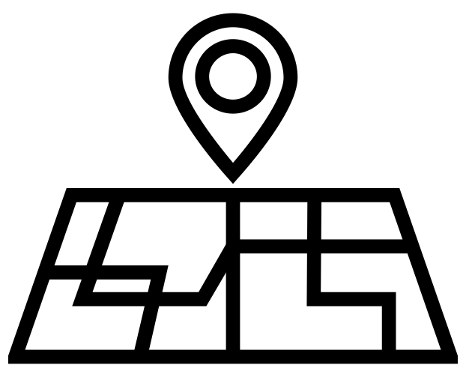

Future Implementations
User Registration
Mobile Application
Donors
Financial Advisors
Financial Literacy Clients
Google Maps API
Notes:
Kevin
User Registration - More detailed user registration (collect better data) Signin - Redirect to the dashboard based on account type Donor Dashboard - Share donations on social media, invite friends Financial Advisor Dashboard - Live advisee budget reading Financial Literacy Dashboard - Plaid integration Admin dashboard - Add admin dashboard to help visualize total user activity
Mobile application port using Ionic

Slide 9

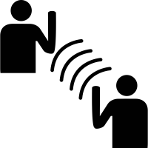
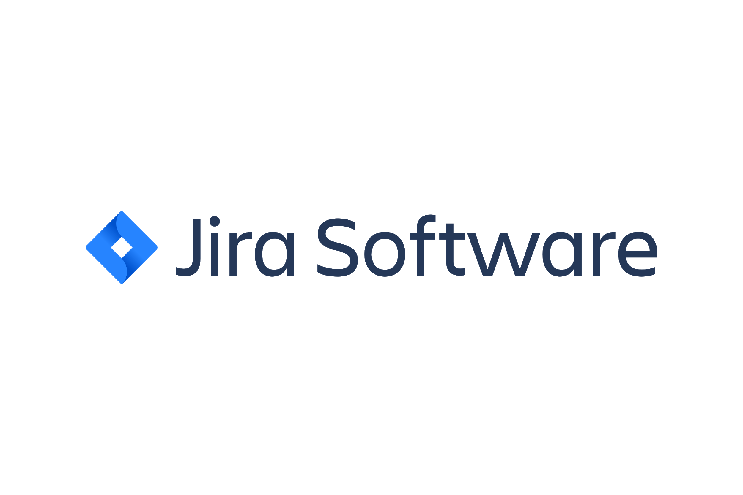


Lessons Learned
Communication
Development Tools
Agile Tools
Notes:
Anazsa
One thing we learned is how to improve communicatio
Our team knew that communication would be a key necessity in order to have a successful product
In order to keep our communication up to par
On zoom calls thru 9-5pm
Learned how to keep contact in tough situation
Learned to use agile tools
Jira to create tasks and user stories
Bit bucket to exchange work through pull requests and push
Constant communication is a necessity, especially with a smaller team
Jira/agile tools
Seth’s Brain
NodeJS, ExpressJS, Mongoose, Bootstrap <- development tools <- teaching new ways to create

Slide 10
Questions?

